Slide 1

Assessment of Client’s Transport Operations
Improving Efficiency & Quality

Slide 2
Agenda
Objectives of the analysis
Volume Metrics
Performance Metrics
WoW Trip Count
Peak Day Shift wise trip pattern
Comparison to Industry Benchmark
Scope of Improvements
How MoveInSync can help

Slide 3
Volume Metrics
ABC has conducted a total of 6.7K trips during the month of Aug’22.
All trips were completed using a fleet of 74 cabs.
Average distance covered by each cab per month is 2,720 kilometers.
The average number of trips per week is 1,343.

Slide 4
Performance Metrics
Ratio of Login v/s Logout trip count : 1.05
Trip count variance through the peak week : 127.18
Average Trips per cab per day : 3.36

Slide 5
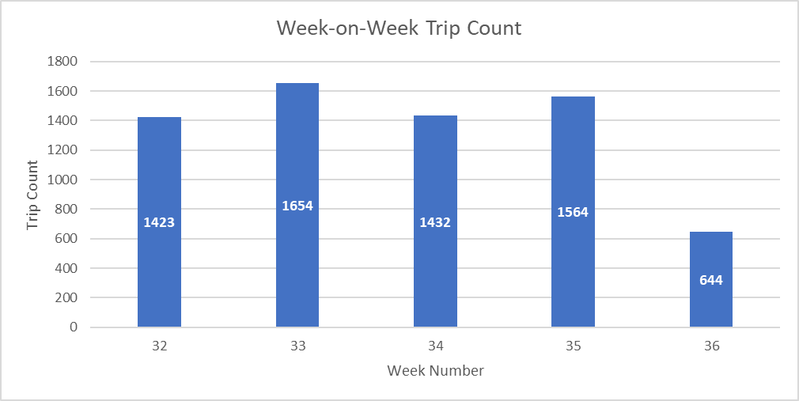
Week-on-Week Trip Count

Slide 6
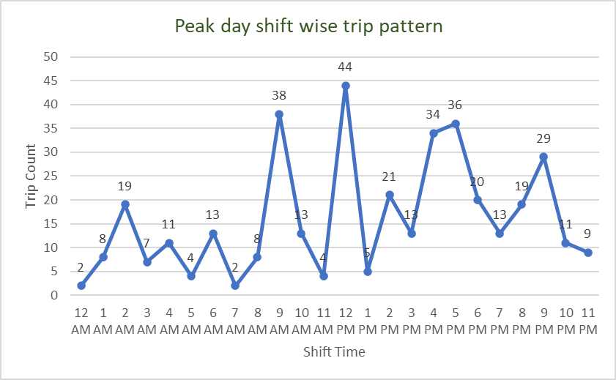
Peak day shift wise trip pattern

Slide 7
Comparison to Industry Benchmark
Metric | Industry Benchmark | ABC's Actuals | Delta Δ
Seat Utilization | 80% | 59% | -21%
No Show | 8% | 6% | -2%
OTA | 95% | 90% | -5%
OTD | 90% | 11% | -79%

Slide 8
Scope of Improvements
Significant improvement can be done in terms of seat utilization.
OTA can be better compared to industry benchmark.
Huge opportunity lies to make on-time-departure efficiently.
Cabs can be utilized in a better way.
Log-in Trip count can be improved.

Slide 9
How MoveInSync Can help
Employee Shuttle Services
Technology Platform
Employee Safety and Security
Coverage Area
Modes of Transportation

Slide 10
Thank you
Ayan Dey
+91-9614708367
ayandey@moveinsync.com
https://moveinsync.com/

